Slide 1
Aviation Accident Investigation based on Model-In-the-Loop Simulation
Yijia Xu
Computer Science Department
Iowa State University

Slide 2
What am I trying to solve?
Make aviation accident investigation easier, safer and faster
Built a Model that could simulate aviation accidents, especially focuses on Singapore Airline 006 accident
I will give examples on how simulation result could assist accident investigation
I will show you the advantage of using MIL simulation for accident investigation

Slide 3
What is Model-In-the-Loop
MIL -- This is a case where you are using a model of the control to work with a model of the plant. The model of the control is probably in Simulink and is connected directly to a physical model of the system within the same Simulink diagram. Extremely fast development occurs at this stage as you can make small changes to the control model and immediately test the system.
SIL -- This is a case where the control model is slightly more "real" in the sense that you are no longer executing the model but rather you have probably coded the model into C or C++ and then inserted this coded model back into your overall plan simulation. This is essentially a test of your coding system (whether autocoded or human coded). Design iteration slows down slightly from MIL but coding failures start to become evident.
HIL -- This is a case where your control system is fully installed into the final control system and can only interact with the plant through the proper IO of the controller. The plant is running on a real-time computer with IO simulations to fool the controller into believing that it is installed on the real plant. In this case, the only difference between the final application and the HIL environment is the fidelity of the plant model and the test vectors that you are using. HIL is often used only for software validation rather than development as the design iteration is very slow at this point. However, this test is closest to the final application and therefore exposes most of the problems that will be seen.
Notes:
MIL model is we create a Simulink Model and simulate it on MATLAB. SIL is convert Simulink model into C code and compile them into binary file under a real time platform. HIL is after compile them into binary code, your inputs are from actual sensors.

Slide 4
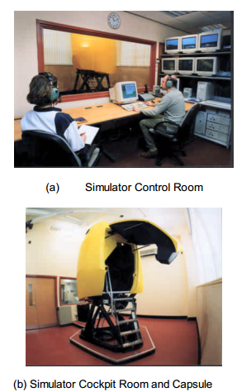
Related Works
White, Mark D., and Gareth D. Padfield. "The use of flight simulation for research and teaching in academia." Proceedings of the AIAA Atmospheric Flight Mechanics Conference. 2006.
Motley, Elizabeth B. Aircraft Accident Survivability: Rotary Wing Aircraft. NAVAL AIR WARFARE CENTER AIRCRAFT DIV PATUXENT RIVER MD, 2005.

Slide 5
What MIL Can Do and Cannot Do
Can Do
Cannot Do
Simulate human errors
Simulate hardware or software errors
Simulate environment parameters that could contributes to accident
Cannot simulate objects without modeling it
Quality of the simulation highly relies on the quality of the model

Slide 6
Simulation Result
Weather: Typhoon, Time: 23:17 Taipei local time
Note: I accelerated the simulation speed 10 times

Slide 7
Who’s fault?
Human Error
Other factors
Pilot chose to take off at dangerous weather condition
The pilot went into the wrong runway for scheduled takeoff
The flight crew ignored the Navigation instruments
Heavy rain and strong winds from typhoon ‘XangSane’
Mid-night
The airport didn’t close the runway during maintenance
Notes:
From the video, we can see that there is a tyhoon. It’s mid night and the airport…
And also, we see, the pilot went into a wrong runway. We know that pilot chose to take off during dangerous weather condition. And the crew ignored….

Slide 8
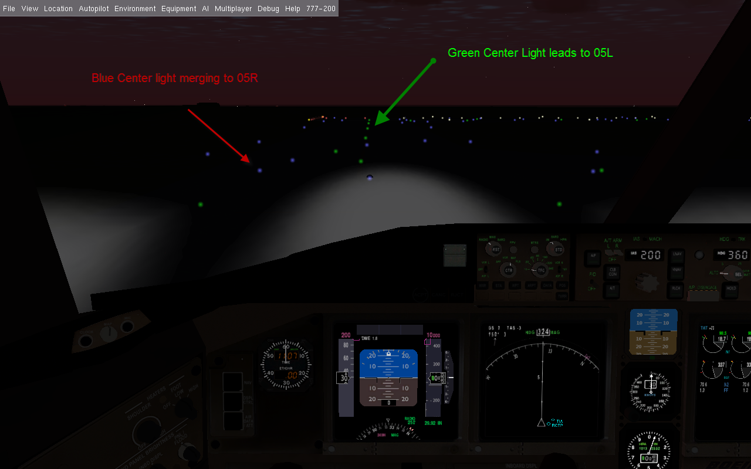
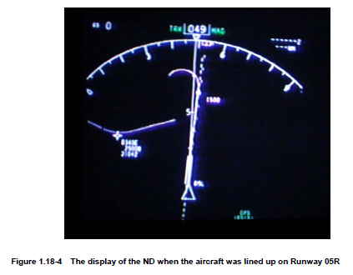
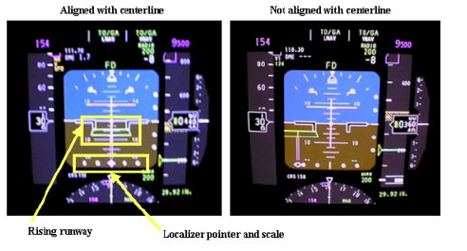
Human Error is the main reason
An inaccurate mental model of what is happening leads to this accident, i.e. They believe they are in the right runway but actually they are not.
They were anxious and wanted to departure before the typhoon hit the airport
They believe they are right and chose to ignore the Para Visual Display (PVD) and Navigation Display (ND)
They had departure from this airport many times and this time they taxied a long time.

Slide 9
Advantage
It is easy to simulate an accident. No hardware required.
No need to shut down the airport for simulation
Applies to a lot of accidents: Mexico Airline 498, Cali…
Safe
…
Notes:
http://www.airdisaster.com/cgi-bin/view_details.cgi?date=08311986&reg=XA-JED&airline=Aeromexico

Slide 10
Future Work
Applying the MIL technology into software testing
Applying the MIL technology into research and teaching in academia

Slide 11
Thank you~~
Questions?

